Slide 1
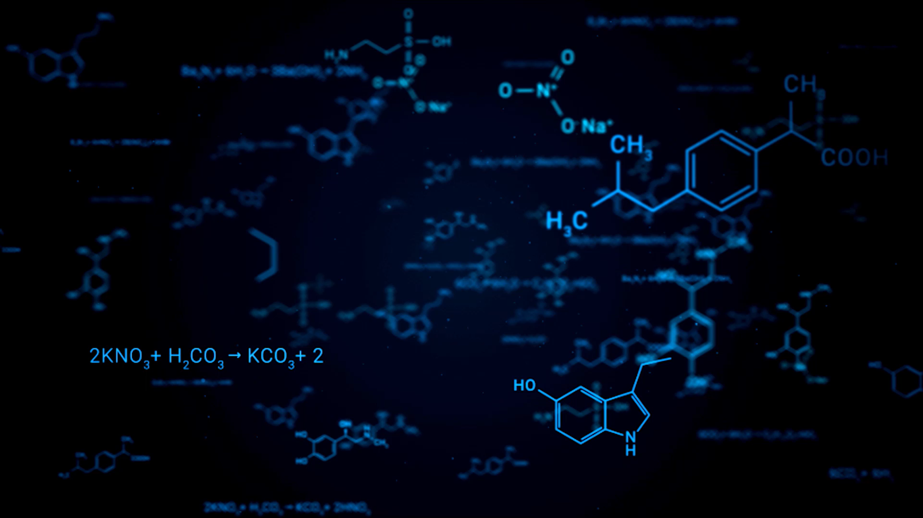
Multiple Sequence Aligner
Team Alignesis
Paolo Lahoud
Sabia Irfan
Dowoo Kim
Aggie Ly
Vladyslav Glezin

Slide 2
Goal?
The Goal of this challenge is to align the sequences as best we can.
Our only available moves are to add gaps between genome sequence.
The way to get the highest score for a row would be that all genome sequences are part of the accepted pair, and that there are no gaps. In that case we would get a score of row_size*bonus.
The goal is to maximize the total sum of our scores on every row. This Problem is NP-Hard, therefore we would need to find a way to optimize the difficulty of the task.
The best way to do that is to find an approximate solution using a ML algorithm.

Slide 3
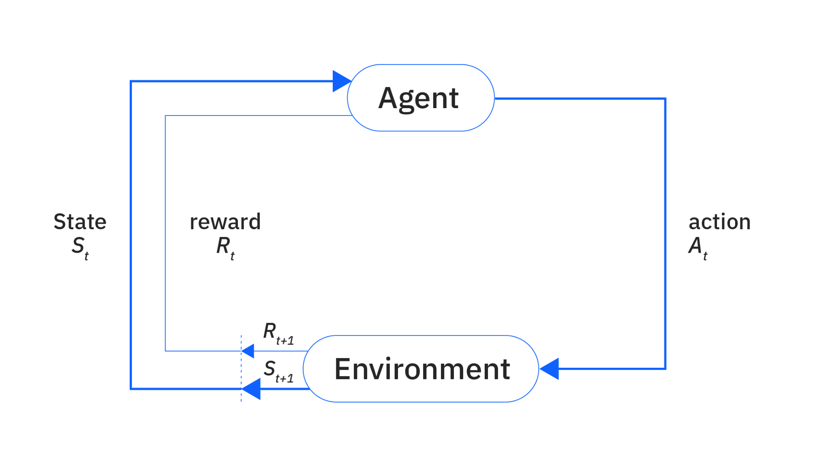
Reinforcement-Learning
Reinforcement Learning:
Pros: Sequential Decision-Making, Exploration of Novel Strategies, Adaptive and Dynamic
Cons: Complexity and Training Stability, Data Efficiency, Credit Assignment Problem
Notes:
Pros:
Sequential Decision-Making:
RL is designed for problems where a sequence of actions affects the final outcome. For MSA, this means the agent can learn which gap insertions improve the final alignment score over multiple moves.
Exploration of Novel Strategies:
RL agents can discover non-intuitive moves by exploring beyond the human-provided moves, potentially leading to innovative alignment strategies.
Adaptive and Dynamic:
RL can adjust its strategy based on the current state of the puzzle, making it well-suited for environments where the effect of a move may be delayed.
Cons:
Complexity and Training Stability:
Training RL models often requires careful tuning (reward shaping, exploration strategies, etc.), and they can be unstable, especially with sparse or delayed rewards.
Data Efficiency:
RL methods usually need many interactions with the environment to learn an effective policy, which might be computationally expensive when simulating puzzle moves.
Credit Assignment Problem:
In MSA, where the effect of a move may only be evident several steps later, determining which move contributed most to the reward can be challenging.

Slide 4
Challenges
Cost Function:
The cost function is the biggest challenge in an RL. In our case the cost function is especially challenging as there is no clear reward. The model’s score can go down before going back up, i.e. we need to insert two gaps in order to have the optimal score.
The first gap would decrease the score, and the second would increase it.
With this in mind we decided to to use the Delta scores as our reward function. I.e. if our total score goes from 10 to 20, the reward is 10, and if it goes from 20 to 15 the reward is -5.

Slide 5
Challenges
Matrix Multiplication for the Neural Net:
All inputs vary in sizes, therefore we couldn’t consistently perform a matrix multiplication.
We decided to add a padding of the size the largest sequence in order to normalize all matrix sizes.

Slide 6
Challenges
Actually Implementing Reinforced Learning:
Even though we understood the challenge and theoretically found what we thought was the optimal solution, we didn’t have the required skills or experience to properly implement it, but we tried our best.

Slide 7
Implementation Steps
Implementing the Training Environment:
We had to create an environment with the appropriate helper functions, such as resetting the environment or checking all available actions at our current state.

Slide 8
Implementation Steps
Implementing the Agent
The Agent has a lot of hyperparameters which require tuning, such as the learning rate, exploration rate…
The NN also needs to be tuned correctly.
These actions are very challenging because of the longer training time of this model. Therefore tuning and testing one hyperparameter could easily take 10 minutes per iteration.

Slide 9
And now for our Results….

Slide 10
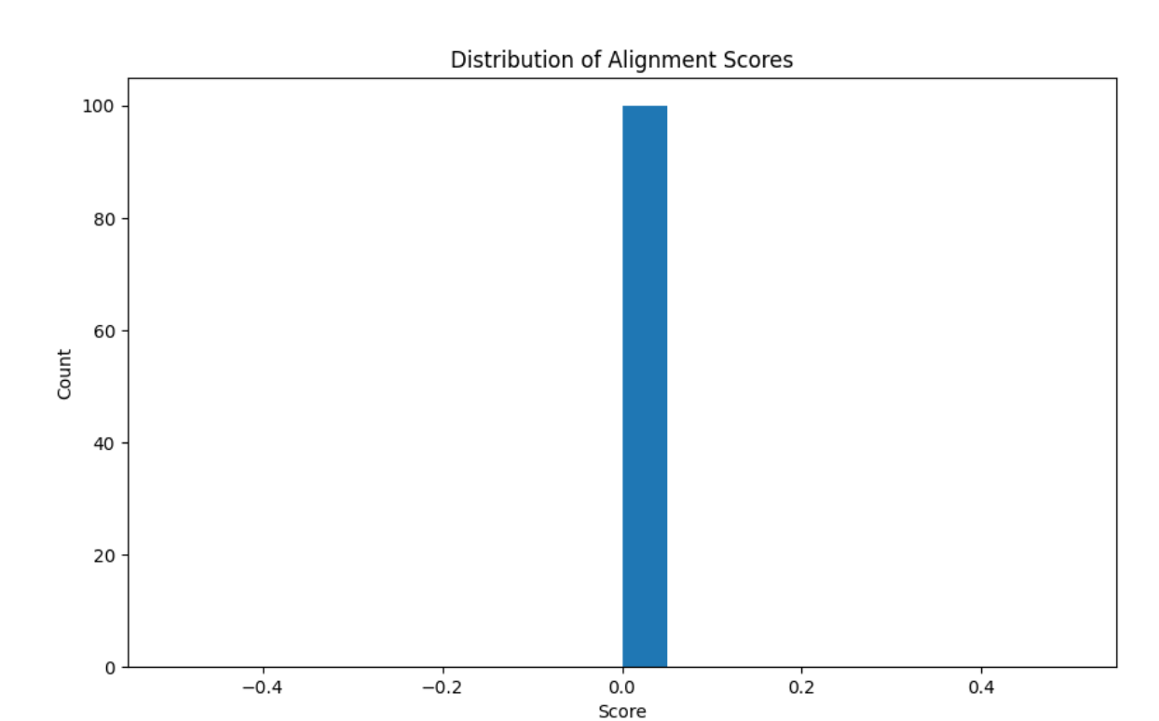

Slide 11
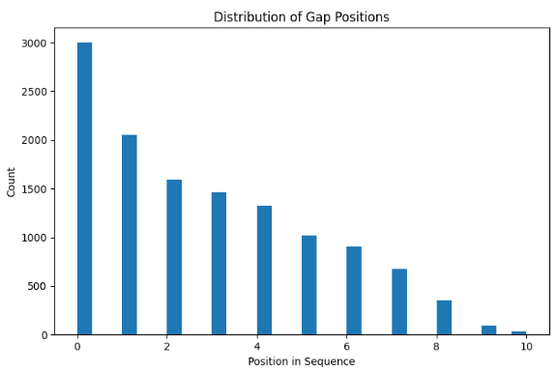
However we do believe our model is learning…
But we probably have an issue with our score calculation.
The model itself merges to 0 as we train it.
We also have a graph which shows us where our model usually adds gaps.

Slide 12
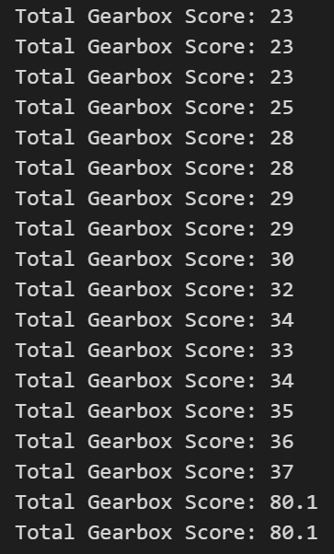
We also have one case where our score would go up!!
(but then we tan into an indexing error)

Slide 13
We tried our best I swear :(

Slide 14
Our Other Models…
XGBoost
Multilayer Perceptron (MLP)

Slide 15
Pros & Cons of the Other Models
Multilayer Perceptron (MLP):
Pros: Simplicity and Speed, Supervised Learning Fit, Efficiency on Tabular Data
Cons: Limited Sequential Understanding, Feature Engineering Requirement, Static Prediction
XGBoost:
Pros: High Performance on Structured Data, Interpretability, Robustness and Efficiency
Cons: Lack of Sequential Decision Handling, Feature Engineering Demand, Inflexibility for Novel Moves
Notes:
Pros:
Simplicity and Speed:
An MLP is relatively straightforward to implement and train, especially if the input is a well-engineered, fixed representation (e.g., flattened puzzle states).
Supervised Learning Fit:
With access to historical moves and final alignment scores, an MLP can be trained in a supervised manner, making it easier to optimize for move prediction.
Efficiency on Tabular Data:
MLPs can quickly learn patterns if the puzzle state is properly encoded and the dataset is large enough (like 400,000 rows).
Cons:
Limited Sequential Understanding:
An MLP doesn’t naturally account for the sequential nature of move decisions. It would need additional engineering (like recurrent or temporal features) to capture the dependencies between moves.
Feature Engineering Requirement:
The performance of an MLP often depends on how well the input state is engineered or pre-processed. In a spatial alignment problem, flattening may lose important spatial relationships.
Static Prediction:
An MLP trained in a supervised manner may only replicate human moves, potentially missing novel strategies that an adaptive approach (like RL) might discover.
Pros:
High Performance on Structured Data:
XGBoost is known for its performance on tabular data and can handle complex interactions if the input features are well-defined.
Interpretability:
Feature importance scores from XGBoost can help identify which aspects of the puzzle state (or engineered features) most influence the alignment score.
Robustness and Efficiency:
It is efficient, often requiring less tuning than deep learning models, and can provide strong baseline predictions.
Cons:
Lack of Sequential Decision Handling:
XGBoost is not designed for sequential decision-making. It would need the sequential moves to be engineered into static features, which may lose the dynamic aspect of the puzzle.
Feature Engineering Demand:
To use XGBoost effectively, you’d need to craft a comprehensive set of features from the puzzle state (and possibly from the history of moves), which can be challenging for spatial alignment problems.
Inflexibility for Novel Moves:
XGBoost models are typically trained in a supervised setting and may not generalize well to novel move sequences or strategies that deviate significantly from the training data.

